Slide 1
Aggregation

Slide 2
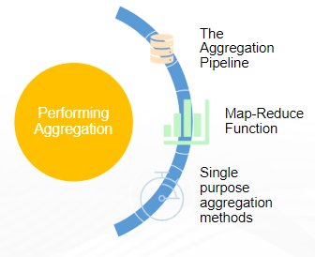
Aggregation Operations
Aggregation operations process multiple documents and return computed results.
Aggregation operations can be used to:
Group values from multiple documents together.
Perform operations on the grouped data to return a single result.
Analyze data changes over time.
Ways to perform aggregation operations:
Aggregation pipelines
Single purpose aggregation methods
The map-reduce function.

Slide 3
Aggregation Pipelines
An aggregation pipeline consists of one or more stages that process documents:
Each stage performs an operation on the input documents. For example, a stage can filter documents, group documents, and calculate values.
The documents that are output from a stage are passed to the next stage.
An aggregation pipeline can return results for groups of documents. For example, return the total, average, maximum, and minimum values.
Aggregation pipelines run with the db.collection.aggregate(pipeline,options) method.

Slide 4
Aggregate stages
$bucket: Categorizes incoming documents into groups, called buckets, based on a specified expression and bucket boundaries.
$group: Groups input documents by a specified identifier expression and applies the accumulator expression(s), if specified, to each group. Consumes all input documents and outputs one document per each distinct group. The output documents only contain the identifier field and, if specified, accumulated fields.
$limit: Passes the first n documents unmodified to the pipeline where n is the specified limit. For each input document, outputs either one document (for the first n documents) or zero documents (after the first n documents).
$lookup: Performs a left outer join to another collection in the same database to filter in documents from the "joined" collection for processing.
$match: Filters the document stream to allow only matching documents to pass unmodified into the next pipeline stage. $match uses standard MongoDB queries. For each input document, outputs either one document (a match) or zero documents (no match).

Slide 5
$merge: Writes the resulting documents of the aggregation pipeline to a collection. The stage can incorporate (insert new documents, merge documents, replace documents, keep existing documents, fail the operation, process documents with a custom update pipeline) the results into an output collection. To use the $merge stage, it must be the last stage in the pipeline.
$out: Writes the resulting documents of the aggregation pipeline to a collection. To use the $out stage, it must be the last stage in the pipeline.
$skip: Skips the first n documents where n is the specified skip number and passes the remaining documents unmodified to the pipeline. For each input document, outputs either zero documents (for the first n documents) or one document (if after the first n documents).
$sort Reorders the document stream by a specified sort key. Only the order changes; the documents remain unmodified. For each input document, outputs one document.
$unwind: Deconstructs an array field from the input documents to output a document for each element. Each output document replaces the array with an element value. For each input document, outputs n documents where n is the number of array elements and can be zero for an empty array.

Slide 6
$match
Definition: Filters the documents to pass only the documents that match the specified condition(s) to the next pipeline stage.
Syntax: db.collection.aggregate({ $match: { <query> } })
Pipeline Optimization: Place the $match as early in the aggregation pipeline as possible. Because $match limits the total number of documents in the aggregation pipeline, earlier $match operations minimize the amount of processing down the pipe.

Slide 7
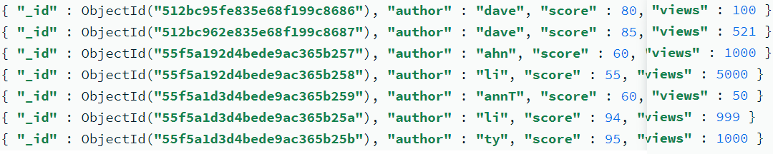

Example:
Equality Match: The following operation uses $match to perform a simple equality match:
The $match selects the documents where the author field equals dave, and the aggregation returns the following:

Slide 8
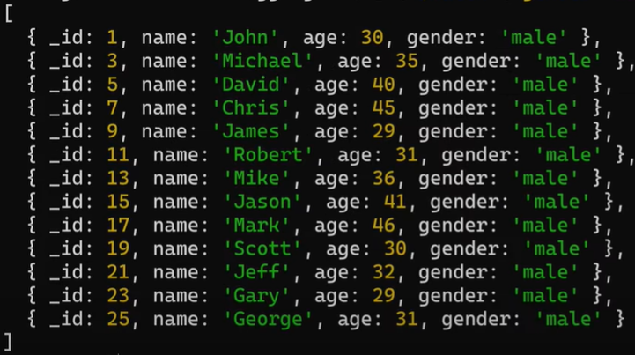

Slide 9
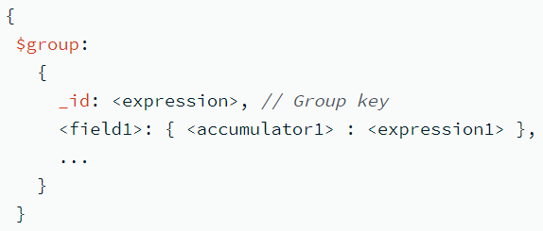
$group
The $group stage separates documents into groups according to a "group key". The output is one document for each unique group key.
A group key is often a field, or group of fields. The group key can also be the result of an expression.
Use the _id field in the $group pipeline stage to set the group key.
In the $group stage output, the _id field is set to the group key for that document.
The output documents can also contain additional fields that are set using accumulator expressions.
$group does not order its output documents.
Syntax:

Slide 10
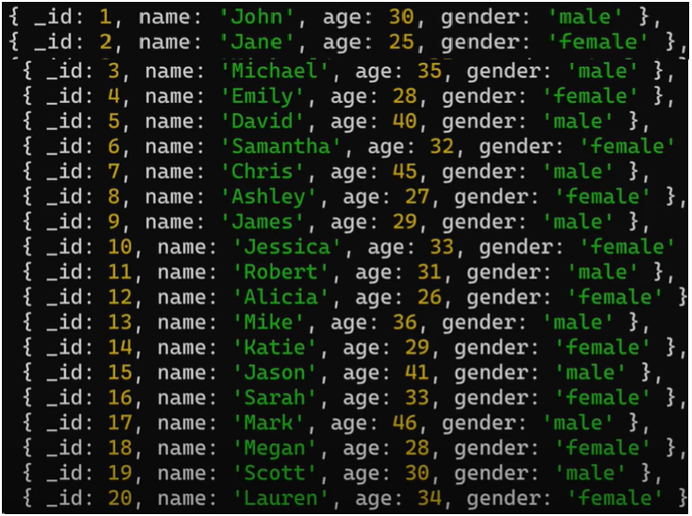
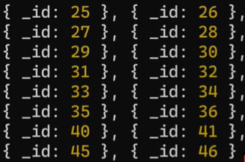
Documents
Output
Query: Group teachers by age

Slide 11
Accumulator Operator
$push: Returns an array of expression values for documents in each group.
$$ROOT: is a reference to the document being processed in the pipeline, which represents the complete document.
$count: Returns the number of documents in a group
$sum: Returns a sum of numerical values. Ignores non-numeric values.
$avg: Returns an average of numerical values. Ignores non-numeric values.
$first: Returns the result of an expression for the first document in a group.
$firstN: Returns an aggregation of the first n elements within a group. Only meaningful when documents are in a defined order. Distinct from the $firstN array operator.
$last: Returns the result of an expression for the last document in a group.
$lastN: Returns an aggregation of the last n elements within a group. Only meaningful when documents are in a defined order. Distinct from the $lastN array operator.
$addToSet : Returns an array of unique expression values for each group. Order of the array elements is undefined.
$bottom: Returns the bottom element within a group according to the specified sort order.
$bottomN: Returns an aggregation of the bottom n fields within a group, according to the specified sort order.
$max : Returns the highest expression value for each group.
$maxN: Returns an aggregation of the n maximum valued elements in a group. Distinct from the $maxN array operator.
$min: Returns the lowest expression value for each group.
$minN: Returns an aggregation of the n minimum valued elements in a group. Distinct from the $minN array operator.

Slide 12

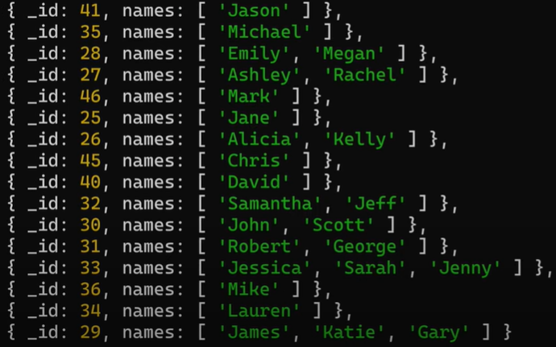
$push
Query: Group teachers by age and show all teachers names per age group
Output:

Slide 13
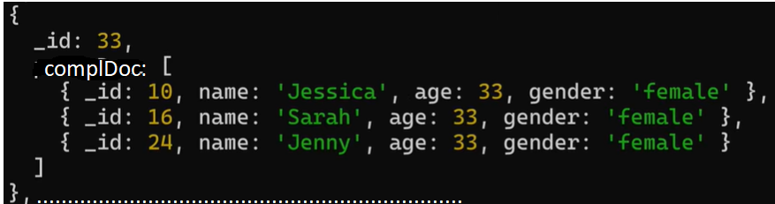
$$ROOT
Query: Group teachers by age and also show complete document per age group
db.teachers.aggregate ( [ {
$group :{ _id: “$age”,
complDoc: {$push: “$$ROOT”
} } }
] )
Output:

Slide 14
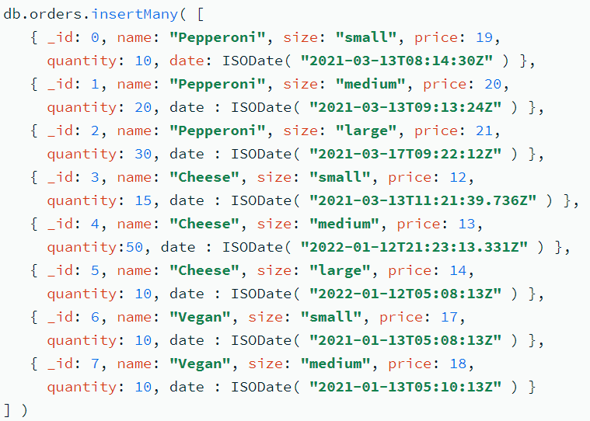
Calculate and return the total order quantity of medium size pizzas grouped by pizza name
db.orders.aggregate( [
$match: { size: "medium" } },
{ $group: { _id: "$name", totalQuantity: { $sum: "$quantity" } } }
] )
$sum

Slide 15
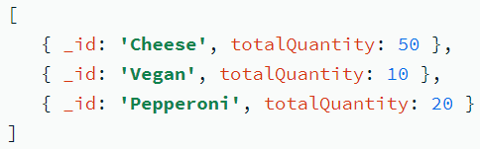
The $match stage:
Filters the pizza order documents to pizzas with a size of medium.
Passes the remaining documents to the $group stage.
The $group stage:
Groups the remaining documents by pizza name.
Uses $sum to calculate the total order quantity for each pizza name. The total is stored in the totalQuantity field returned by the aggregation pipeline.
db.orders.aggregate( [
$match: { size: "medium" } },
{ $group: { _id: "$name", totalQuantity: { $sum: "$quantity" } } }
] )

Slide 16
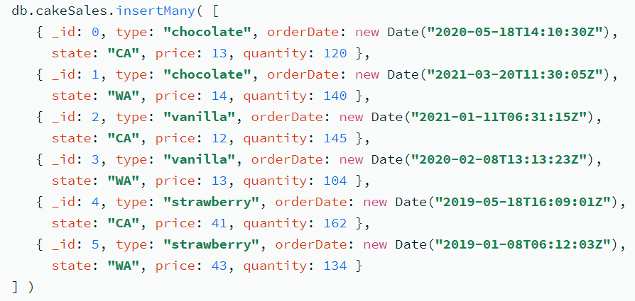
$count
Returns the number of documents in a group.
Syntax: { $count: { } }
$count does not accept any parameters.
$count is functionally equivalent to using { $sum : 1 } within the $group stage.

Slide 17
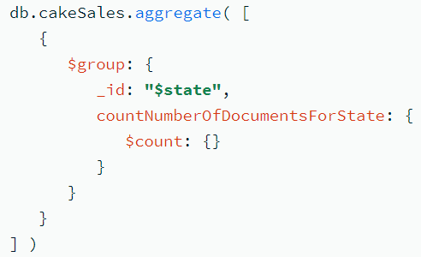

Query: count the number of documents in the cakeSales collection for each state
In the example:
_id: "$state" groups the documents by the state field value. There are groups for CA and WA.
$count: {} sets the countNumberOfDocumentsForState field to the number of documents that share the same state field value.

Slide 18
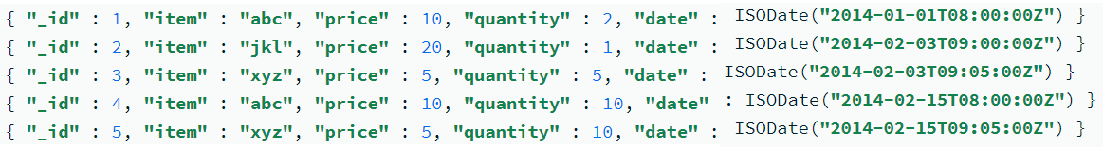
$max
Returns the maximum value. $max compares both value and type, using the specified BSON comparison order for values of different types.
Syntax: { $max: <expression> }
Null or Missing Values:
If some, but not all, documents for the $max operation have either a null value for the field or are missing the field, the $max operator only considers the non-null and the non-missing values for the field.
If all documents for the $max operation have null value for the field or are missing the field, the $max operator returns null for the maximum value.

Slide 19
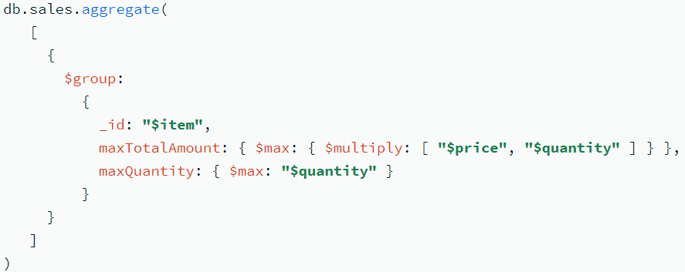

Grouping the documents by the item field, the following operation uses the $max accumulator to compute the maximum total amount and maximum quantity for each group of documents.
Output:

Slide 20
$min
Returns the minimum value.
$min compares both value and type, using the specified BSON comparison order for values of different types.
Syntax: { $min: <expression> }
Null or Missing Values:
If some, but not all, documents for the $min operation have either a null value for the field or are missing the field, the $min operator only considers the non-null and the non-missing values for the field.
If all documents for the $min operation have null value for the field or are missing the field, the $min operator returns null for the minimum value.

Slide 21
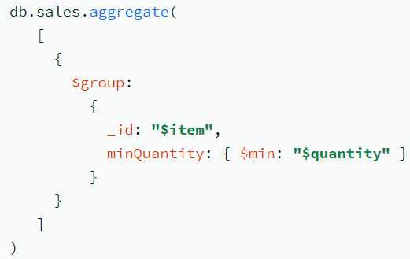
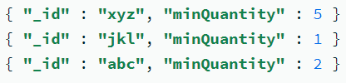
Grouping the documents by the item field, the following operation uses the $min accumulator to compute the minimum amount and minimum quantity for each grouping.
Output:

Slide 22
$avg
Returns the average value of the numeric values.
$avg ignores non-numeric values.
Syntax: { $avg: <expression> }
Non-numeric or Missing Values:
$avg ignores non-numeric values, including missing values. If all of the operands for the average are non-numeric, $avg returns null since the average of zero values is undefined.

Slide 23
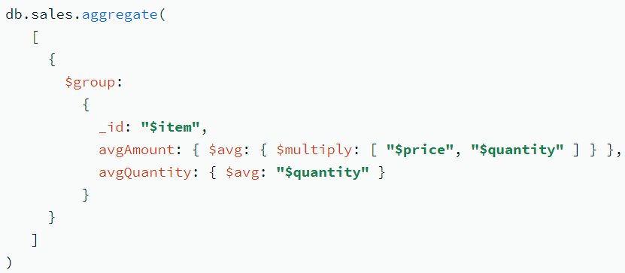

Grouping the documents by the item field, the following operation uses the $avg accumulator to compute the average amount and average quantity for each grouping.
Output:

Slide 24
Aggregate stage - $limit:
Limits the number of documents passed to the next stage in the pipeline.
Syntax: { $limit: <positive 64-bit integer> }
Example: db.article.aggregate([ { $limit : 5 }]);
This operation returns only the first 5 documents passed to it by the pipeline. $limit has no effect on the content of the documents it passes.
Aggregate stage $skip:
Skips over the specified number of documents that pass into the stage and passes the remaining documents to the next stage in the pipeline.
Syntax: { $skip: <positive 64-bit integer> }
Example: db.article.aggregate([ { $skip : 5 }]);
This operation skips the first 5 documents passed to it by the pipeline. $skip has no effect on the content of the documents it passes along the pipeline.

